Slide 1
Meadowhead Community Infant School & Nursery
Remote Learning
Remote Learning

Slide 2
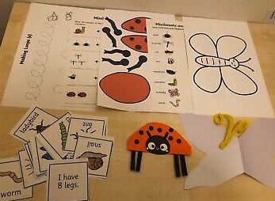
How are we providing remote learning?
We are providing remote learning to the children in many different ways. This multi-platform approach has enabled and encouraged more children to access the learning.
We are currently using:
Class Dojo – ClassDojo is a school communication platform that teachers, students, and families use every day to share what is being learned in the classroom and at home through photos, videos, and messages.
Zoom - Zoom is a video conferencing service you can use to virtually meet with others - either by video, audio or both.
Home learning packs – Home learning packs are weekly packs made up by each teacher with differentiated worksheets, explanations of how to complete the learning, books and resources.
Daily Timetable – A daily timetable is sent out for each day to help with the structure of the day and to provide necessary information or links for that day’s learning.

Slide 3
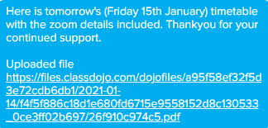
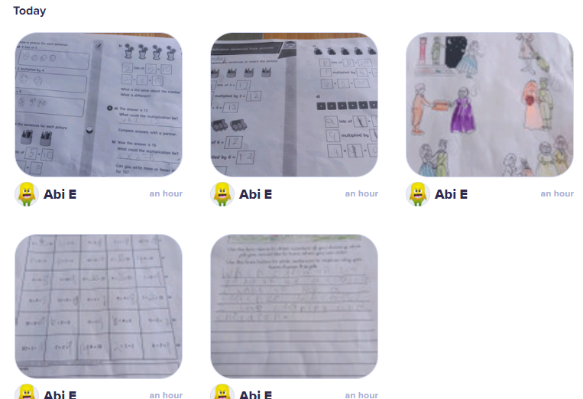
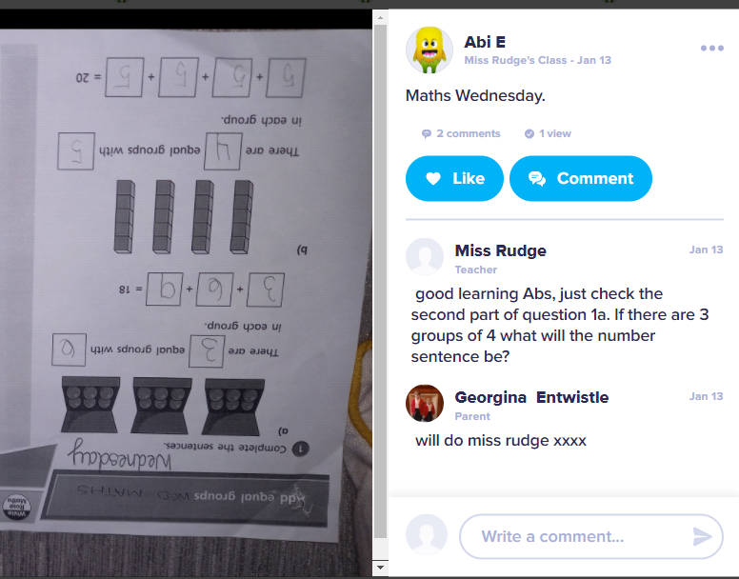
Class Dojo
Every evening a message is sent out to all parents via class dojo message and class dojo story.
The message contains a file which has the daily timetable for the next day and the details to access
the Zoom call included.
Class Dojo also has a section called ‘portfolio’ where the children can upload their learning.
The children have the option of sending a video, photo or worksheet back via class dojo for the
teacher to assess and give feedback.

Slide 4
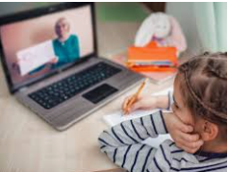
Zoom
Every day each teacher is providing two ‘live learning’ meetings via Zoom, one in the morning and one in the afternoon. The sessions are very beneficial as the children are able to:
Listen to an input for the day’s learning ahead and ask any necessary questions.
Complete a WAGOLL with the teacher to further help understanding.
Play games with their classmates and teacher.
Have a class story read by the teacher.
Their favourite part – share any news / show and tell!

Slide 5
Home Learning Packs
Teachers make up a weekly pack which is dropped off at the pupil’s house every Thursday in preparation for the following week. The pack contains:
Two reading books which are ability appropriate for each individual child.
Worksheets for each lesson separated into the different days of the week to help with confusion and ensure the children don’t rush through all of their learning in one day.
Any resources needed to complete activities.
A message from the teacher to praise the previous week’s home learning and encouragement for the following week.
We have found learning packs have helped immensely with engagement of remote learning. Some children share devices with siblings, have poor internet connection or have parents who are working from home who cannot assist with uploading work to class dojo. The home learning packs enable the children to complete learning with some independence if support / devices are not available.

Slide 6
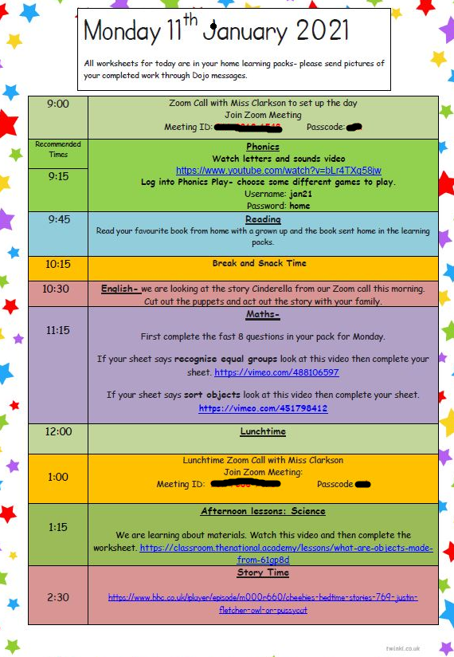
Daily Timetable
The daily time table provides :
The username, password and time for the morning and afternoon Zoom lesson for that day.
Recommended times for learning for the day.
A brief explanation of each lesson (which is reinforced through the morning and afternoon Zoom session).
Links to any videos / games / websites to support the lesson.
Link to a home time story.

Slide 7
How are we encouraging and monitoring engagement?
We have tried to encourage engagement by making it as easy as possible to access the learning:
Messages of encouragement for parents to offer support and understanding
Daily message on dojo with the following days timetable
Daily update on the class story (Dojo) with the following days timetable
Daily updates via email for any parents struggling to access Class Dojo
A weekly text message to all parents with Zoom lesson information
Home learning packs for all children and laptops to those parents need help accessing the online content
We are monitoring engagement by:
Zoom registers taken for each Zoom session
Monitor of work uploaded through Dojo portfolio
When handing out new learning packs we are taking in the old learning packs to see who is completing the work set
Phone calls, dojo messages and text messages are sent to children who are not engaging with Zoom lessons, uploading work via dojos or completing work in the learning packs.
The names of the children who are not engaging and who we are unable to make contact with are then sent on to James and Jodie (pupil wellbeing officer).

